Slide 1
Module 5: Security Management

Slide 2
How to use Ansible Vault
Vaults and Playbooks
Encrypting user passwords
Hiding passwords

Slide 3
Topic List
How to use Ansible Vault
Vaults and Playbooks
Encrypting user passwords
Hiding passwords

Slide 4
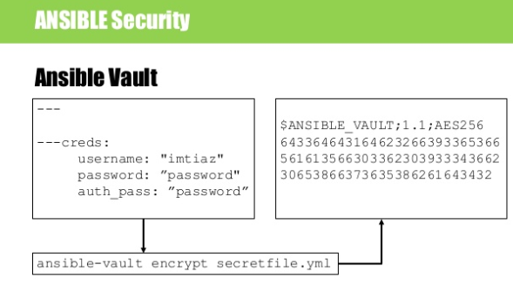
Ansible Vault
What is Ansible Vault
Ansible Vault is a feature of ansible that allows you to keep sensitive data such as passwords or keys in encrypted files, rather than as plaintext in playbooks or roles. These vault files can then be distributed or placed in source control.
To enable this feature, a command line tool - ansible-vault - is used to edit files, and a command line flag (--ask-vault-pass or --vault-password-file) is used. Alternately, you may specify the location of a password file or command Ansible to always prompt for the password in your ansible.cfg file. These options require no command line flag usage.
Notes:
Ansible Vault can encrypt any structured data file used by Ansible. This can include “group_vars/” or “host_vars/” inventory variables, variables loaded by “include_vars” or “vars_files”, or variable files passed on the ansible-playbook command line with -e @file.yml or -e @file.json. Role variables and defaults are also included.

Slide 5
Creating Encrypted Files
To create a new encrypted data file, run the following command:
> ansible-vault create foo.yml
First you will be prompted for a password. The password used with vault currently must be the same for all files you wish to use together at the same time.
After providing a password, the tool will launch whatever editor you have defined with $EDITOR, and defaults to vi (before 2.1 the default was vim). Once you are done with the editor session, the file will be saved as encrypted data.
The default cipher is AES (which is shared-secret based).

Slide 6
Editing encrypted files
To edit an encrypted file in place, use the ansible-vault edit command. This command will decrypt the file to a temporary file and allow you to edit the file, saving it back when done and removing the temporary file:
> ansible-vault edit foo.yml
Rekeying Encrypted Files
Should you wish to change your password on a vault-encrypted file or files, you can do so with the rekey command:
> ansible-vault rekey foo.yml bar.yml baz.yml
This command can rekey multiple data files at once and will ask for the original password and also the new password.

Slide 7
Encrypting Unencrypted Files
If you have existing files that you wish to encrypt, use the ansible-vault encrypt command. This command can operate on multiple files at once:
> ansible-vault encrypt foo.yml bar.yml baz.yml
Decrypting Encrypted Files
If you have existing files that you no longer want to keep encrypted, you can permanently decrypt them by running the ansible-vault decrypt command. This command will save them unencrypted to the disk, so be sure you do not want ansible-vault edit instead:
> ansible-vault decrypt foo.yml bar.yml baz.yml
If you want to view the contents of an encrypted file without editing it, you can use the ansible-vault view command:
> ansible-vault view foo.yml bar.yml baz.yml

Slide 8
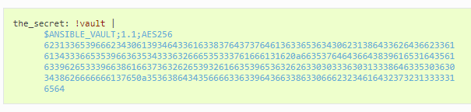
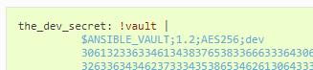
Use encrypt_string to create encrypted variables to embed in yaml
The ansible-vault encrypt_string command will encrypt and format a provided string into a format that can be included in ansible-playbook YAML files.
To encrypt a string provided as a cli arg:
> ansible-vault encrypt_string --vault-id a_password_file 'foobar' --name 'the_secret'
Result:
To use a vault-id label for ‘dev’ vault-id:
> ansible-vault encrypt_string --vault-id dev@password 'foooodev' --name 'the_dev_secret'
Result:

Slide 9
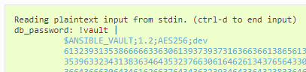
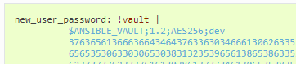
To encrypt a string read from stdin and name it ‘db_password’:
> echo -n 'letmein' | ansible-vault encrypt_string --vault-id dev@password --stdin-name 'db_password’
Result:
To be prompted for a string to encrypt, encrypt it, and give it the name ‘new_user_password’:
>ansible-vault encrypt_string --vault-id dev@./password --stdin-name 'new_user_password'
Output:
Reading plaintext input from stdin. (ctrl-d to end input)
User enters ‘hunter2’ and hits ctrl-d.

Slide 10
Vault Ids and Multiple Vault Passwords
A vault id is an identifier for one or more vault secrets. Since Ansible 2.4, Ansible supports multiple vault passwords. Vault ids is a way to provide a label for a particular vault password.
Vault encrypted content can specify which vault id it was encrypted with.
Prior to Ansible 2.4, only one vault password could be used at a time. Post Ansible 2.4, multiple vault passwords can be used each time Ansible runs, so any vault files or vars that needed to be decrypted all had to use the same password.
Since Ansible 2.4, vault files or vars that are encrypted with different passwords can be used at the same time.
For example, a playbook can now include a vars file encrypted with a ‘dev’ vault id and a ‘prod’ vault id.

Slide 11
Providing Vault Passwords
Since Ansible 2.4, the recommended way to provide a vault password from the cli is to use the --vault-id cli option.
For example, to use a password store in the text file /path/to/my/vault-password-file:
> ansible-playbook --vault-id /path/to/my/vault-password-file site.yml
To prompt for a password:
> ansible-playbook --vault-id @prompt site.yml
To get the password from a vault password executable script my-vault-password.py:
> ansible-playbook --vault-id my-vault-password.py
The value for --vault-id can specify the type of vault id (prompt, a file path, etc) and a label for the vault id (‘dev’, ‘prod’, ‘cloud’, etc)
For example, to use a password file dev-password for the vault-id ‘dev’:
> ansible-playbook --vault-id dev@dev-password site.yml
To prompt for the ‘dev’ vault id:
> ansible-playbook --vault-id dev@prompt site.yml

Slide 12
To be prompted for a vault password, use the --ask-vault-pass cli option:
> ansible-playbook --ask-vault-pass site.yml
To specify a vault password in a text file ‘dev-password’, use the --vault-password-file option:
> ansible-playbook --vault-password-file dev-password site.yml
There is a config option (DEFAULT_VAULT_PASSWORD_FILE) to specify a vault password file to use without requiring the --vault-password-file cli option.

Slide 13
Using Vault in playbooks
The “Vault” is a feature of Ansible that allows you to keep sensitive data such as passwords or keys in encrypted files, rather than as plaintext in playbooks or roles. These vault files can then be distributed or placed in source control.
To enable this feature, a command line tool, ansible-vault is used to edit files, and a command line flag --ask-vault-pass or --vault-password-file is used. You can also modify your ansible.cfg file to specify the location of a password file or configure Ansible to always prompt for the password. These options require no command line flag usage.
For best practices advice, refer to Variables and Vaults.

Slide 14
Running a Playbook With Vault
To run a playbook that contains vault-encrypted data files, you must pass one of two flags. To specify the vault-password interactively:
>ansible-playbook site.yml --ask-vault-pass
This prompt will then be used to decrypt (in memory only) any vault encrypted files that are accessed. Currently this requires that all files be encrypted with the same password.
Alternatively, passwords can be specified with a file or a script (the script version will require Ansible 1.7 or later). When using this flag, ensure permissions on the file are such that no one else can access your key and do not add your key to source control:
>ansible-playbook site.yml --vault-password-file ~/.vault_pass.txt
>ansible-playbook site.yml --vault-password-file ~/.vault_pass.py
The password should be a string stored as a single line in the file.

Slide 15
Note
You can also set ANSIBLE_VAULT_PASSWORD_FILE environment variable, e.g. ANSIBLE_VAULT_PASSWORD_FILE=~/.vault_pass.txt and Ansible will automatically search for the password in that file.
If you are using a script instead of a flat file, ensure that it is marked as executable, and that the password is printed to standard output. If your script needs to prompt for data, prompts can be sent to standard error.
This is something you may wish to do if using Ansible from a continuous integration system like Jenkins.
The --vault-password-file option can also be used with the ansible-pull command if you wish, though this would require distributing the keys to your nodes, so understand the implications – vault is more intended for push mode.

Slide 16
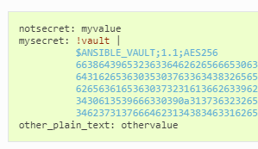
Single Encrypted Variable
As of version 2.3, Ansible can now use a vaulted variable that lives in an otherwise ‘clear text’ YAML file:
To create a vaulted variable, use the ansible-vault encrypt_string command. See Using encrypt_string for details.
This vaulted variable will be decrypted with the supplied vault secret and used as a normal variable. The ansible-vault command line supports stdin and stdout for encrypting data on the fly, which can be used from your favorite editor to create these vaulted variables; you just have to be sure to add the !vault tag so both Ansible and YAML are aware of the need to decrypt. The | is also required, as vault encryption results in a multi-line string.

Slide 17
What is playbook, understanding the anatomy of a playbook and running a playbook
How to create reusable playbooks
Roles
Variables and modules
Understanding inventory file and how to use it for scaling to multiple hosts
Creating the Ansible user
Jinja2 Templates
Conditionals
Variables
Filters

